Slide 1

Towards Conversational Diagnostic AI
Author: Tao Tu, Anil Palepu, Mike Schaekermann, et al.

Slide 2
BACKGROUND
Built on PaLM 2
Google’s 2023 LLM; stronger reasoning, multilingual, coding than PaLM-1; faster/more efficient.
AMIE builds on PaLM 2 and adds self-play training + online reasoning + OSCE evaluation to make a clinician-style conversational agent.
Why conversational, not static QA
Real clinics need multi-turn history-taking, differential diagnosis (DDx), management plans, and empathetic communication.
AMIE explicitly targets this workflow: ask → reason → propose DDx/next steps → explain to patient.
What is OSCE
A standardized, multi-station practical exam with standardized patients and rubrics.
Scores multiple dimensions: history completeness, diagnostic reasoning, management choices, communication/empathy.

Slide 3
Paper Background
arXiv (v1): Jan 11, 2024 -> Nature (online): Apr 9, 2025
Not open-sourcing model code/weights
Evaluation is a text-chat OSCE simulation
Meanwhile, field focus shifted: broad “agent” hype cooled; emphasis moved to clinician-in-the-loop oversight, safety/compliance, multimodality, and real-world validation.
Thus, AMIE’s value is methodological integration + clinical-grade evaluation (OSCE) rather than a brand-new backbone.

Slide 4
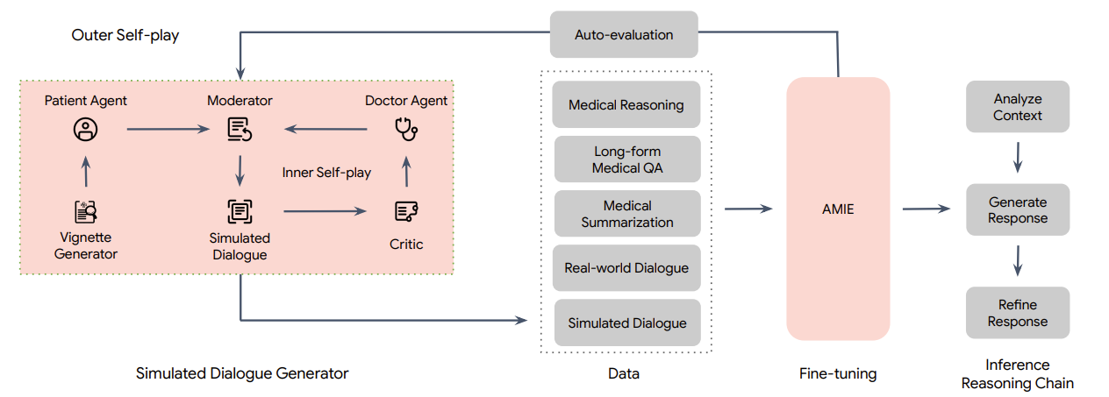
AMIE Training Pipeline

Slide 5
Related Work
AgentClinic: a multimodal agent benchmark to evaluate AI in simulated clinical environments

